Slide 1
Network Management

Slide 2
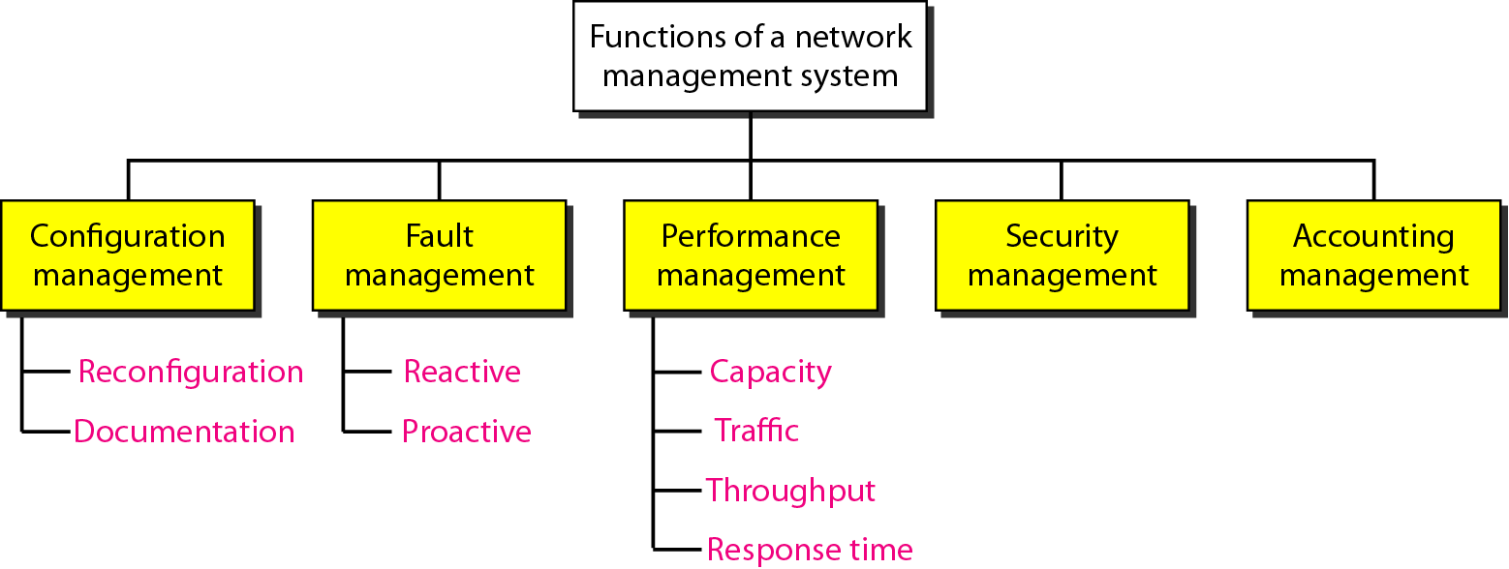
Network Management

Slide 3
Configuration Management
The configuration management system must know, at any time, the status of each entity and its relation to other entities. Configuration management can be divided into two subsystems:
  reconfiguration and documentation.
Reconfiguration, which means adjusting the network components and features, can be a daily occurrence in a large network.
There are three types of reconfiguration:
  hardware reconfiguration,
  software reconfiguration, &
  user-account reconfiguration.
Documentation :The original network configuration and each subsequent change must be recorded meticulously. This means that there must be documentation for hardware, software, and user accounts.

Slide 4
Fault Management
An effective fault management system has two subsystems: reactive fault management and proactive fault management.
Reactive Fault Management
A reactive fault management system is responsible for detecting, isolating, correcting, and recording faults. It handles short-term solutions to faults.
After the fault is corrected, it must be documented.
The record should show the exact location of the fault, the possible cause, the action or actions taken to correct the fault, the cost, and time it took for each step.
Proactive Fault Management
Proactive fault management tries to prevent faults from occurring.
Although this is not always possible, some types of failures can be predicted and prevented.

Slide 5
Performance Management
Performance management, which is closely related to fault management, tries to monitor and control the network to ensure that it is running as efficiently as possible.
Performance management tries to quantify performance by using some measurable quantity such as capacity, traffic, throughput, or response time.
Capacity : Every network has a limited capacity, and the performance management system must ensure that it is not used above this capacity.
Traffic : Traffic can be measured in two ways: internally and externally.
Internal traffic is measured by the number of packets traveling inside the network. External traffic is measured by the exchange of packets outside the network.
Response Time : Response time is normally measured from the time a user requests a service to the time the service is granted.

Slide 6
Security Management
Security management is responsible for controlling access to the network based on the predefined policy.

Slide 7
Accounting Management
Accounting management is the control of users' access to network resources through charges.
Under accounting management, individual users, departments, divisions, or even projects are charged for the services they receive from the network.

